Slide 1


ESSE3
SUBJECT ENROLMENT

Slide 2

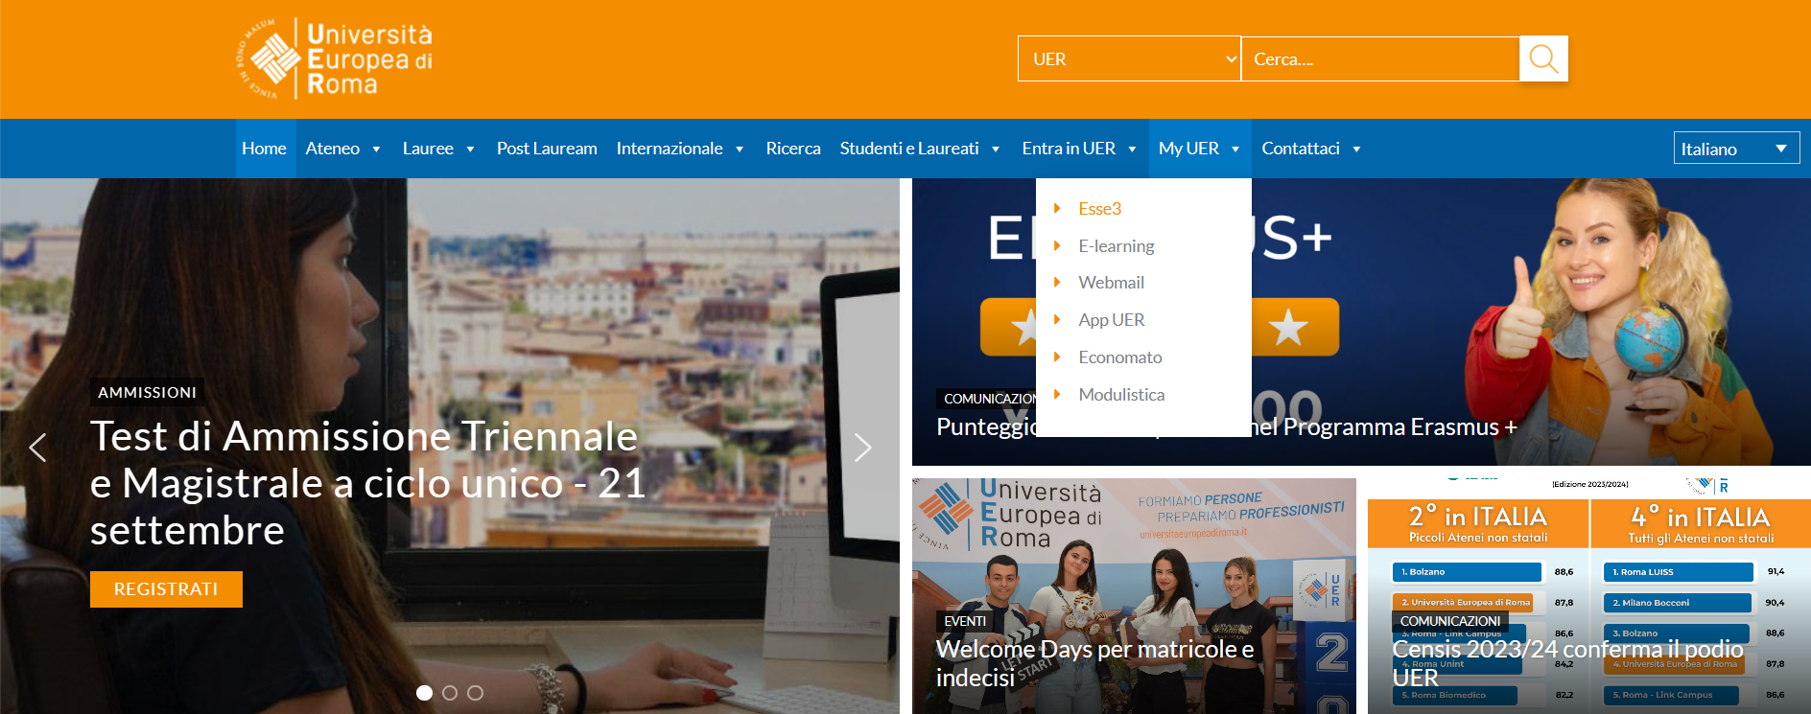
1. Go to
MyUER > Esse3

Slide 3
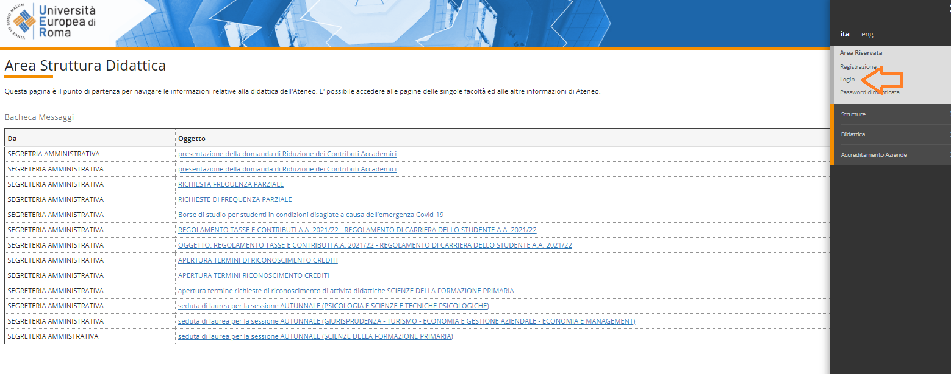
2. Menu > Login

Slide 4
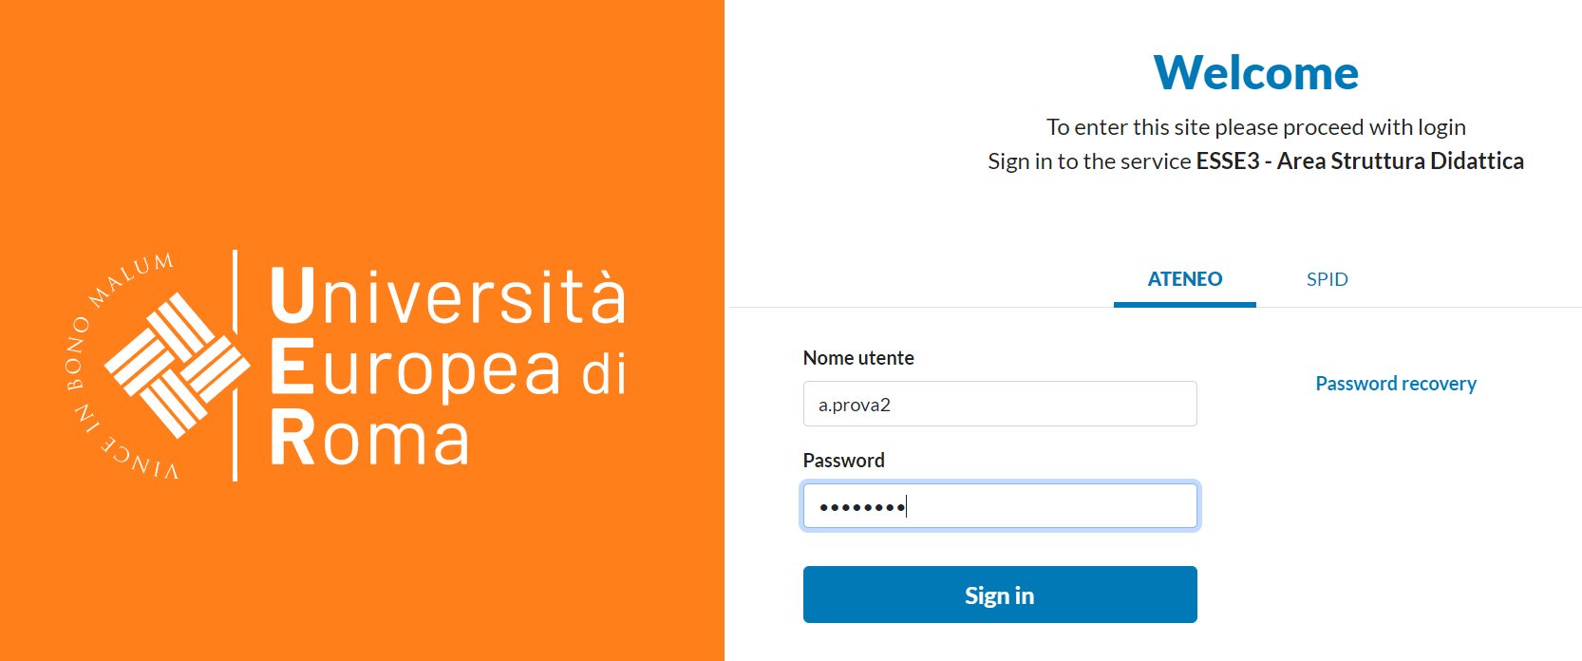
3. Use your Esse3 credentials to log in > Sign in

Slide 5
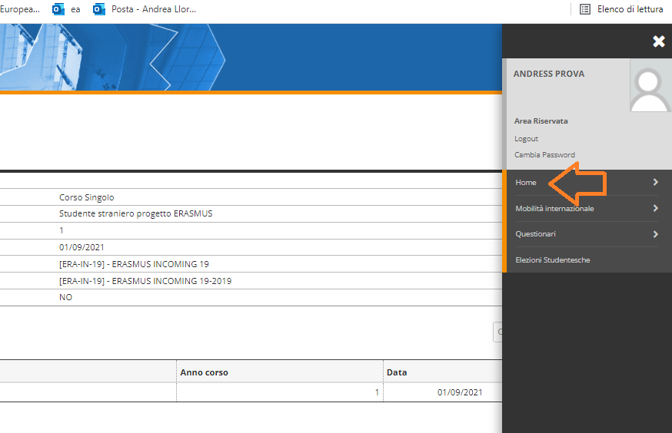
4. Menu >Home

Slide 6
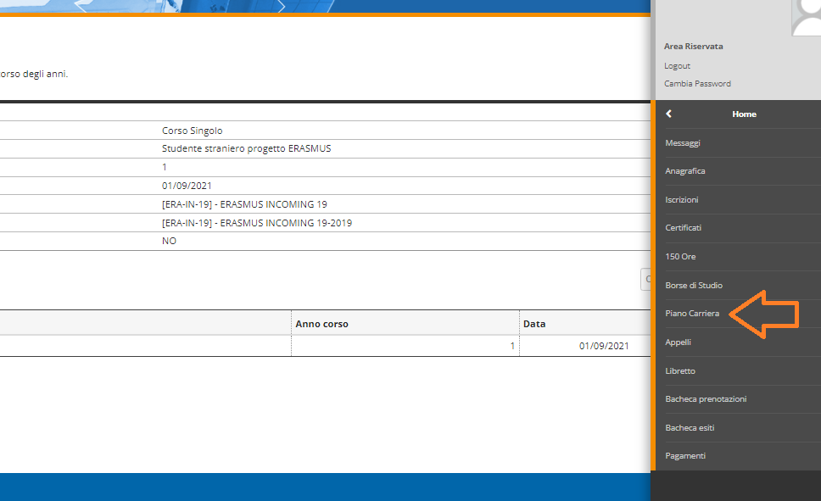
5. Piano carriera

Slide 7
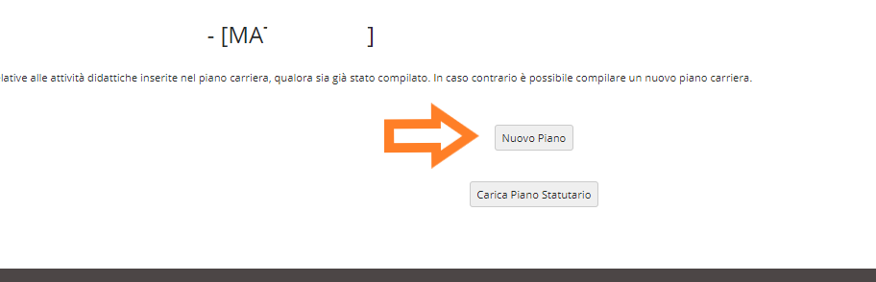
6. Nuovo piano

Slide 8
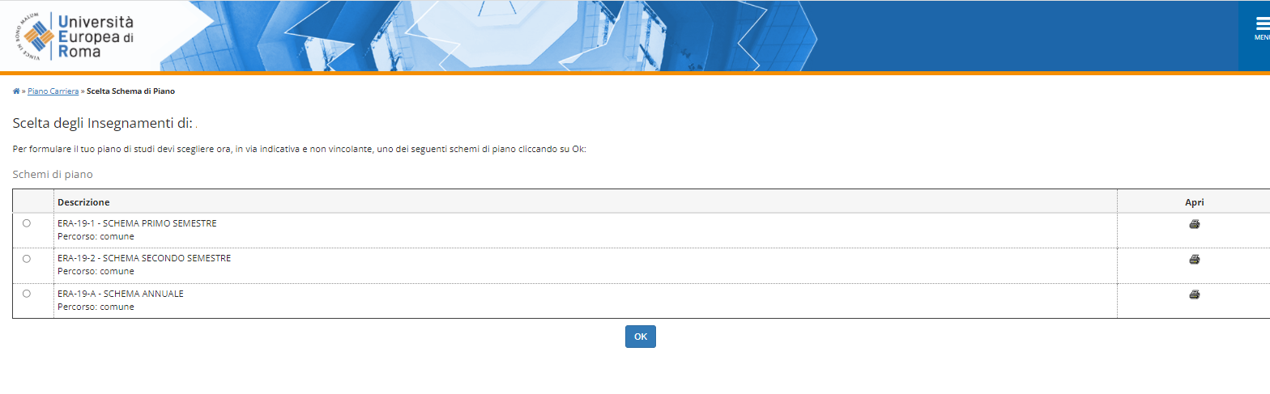
If you are studying at UER only during the first semester, click on ERA-IN-1-SCHEMA PRIMO SEMESTRE
If you are studying at UER the whole academic year, click on ERA-IN-A-SCHEMA ANNUALE
>OK

Slide 9
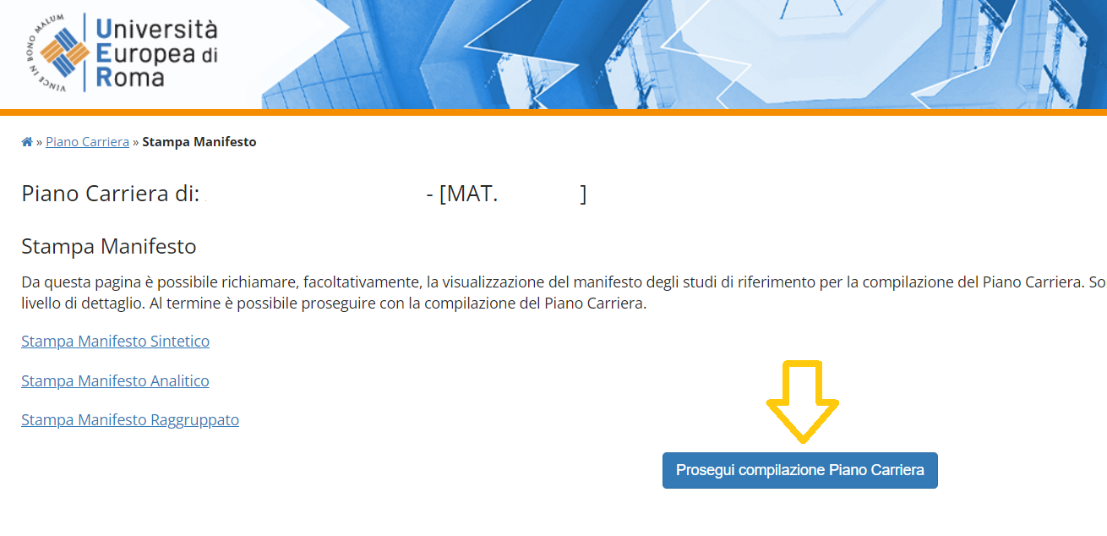
7. Prosegui compilazione Piano Carriera

Slide 10
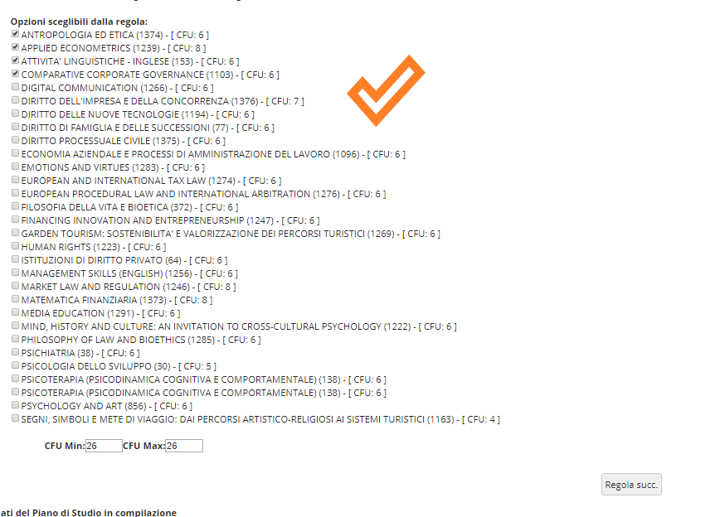
8. Click on the subjects contained in your
Learning Agreement Before Mobility/Predictamen.
Mind the ECTS (=CFU)

Slide 11
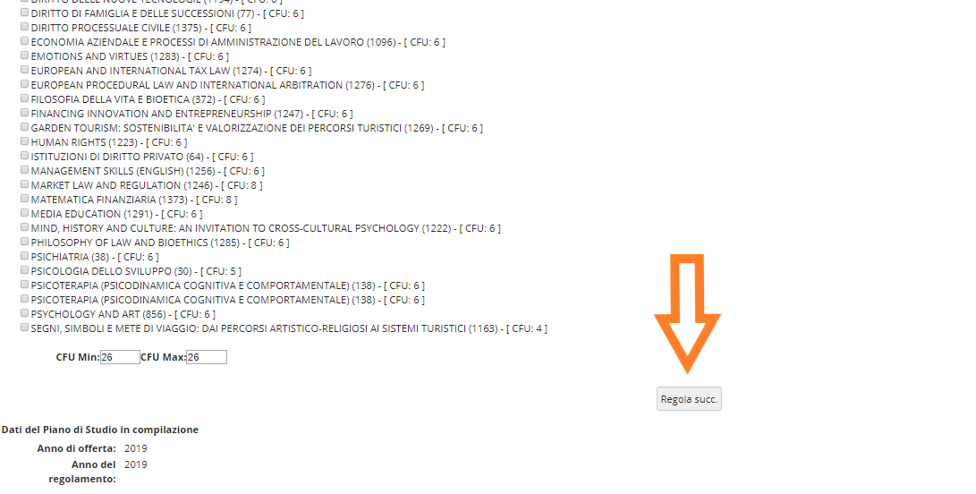
9. Regola succ.

Slide 12
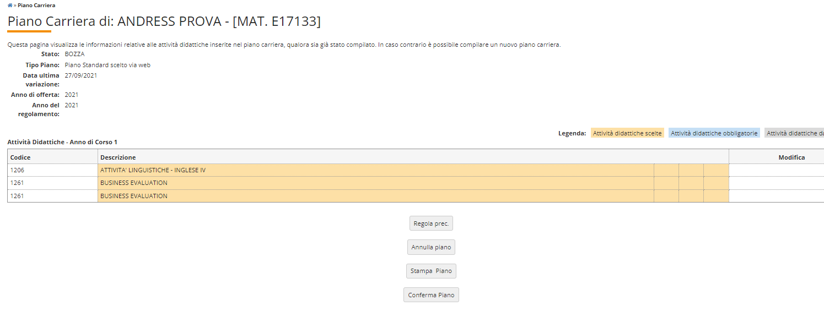
10. Conferma piano > Conferma definitivamente

Slide 13
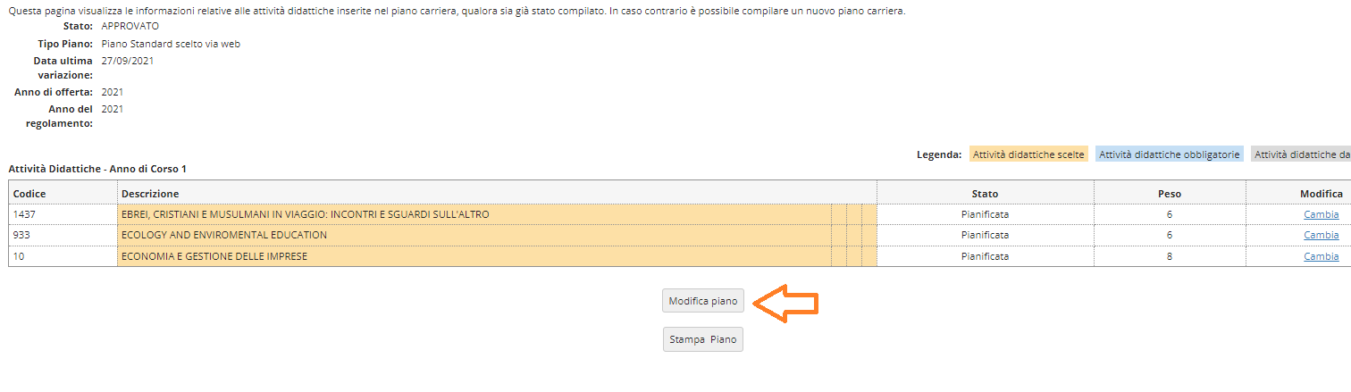
Changing the courses
If within October 4th you need to make changes, please:
Login>Home>Piano carriera>Modifica Piano

Slide 14

You will not be able to change the Piano Carriera after October 4th (Learning Agreement During/Dictamen Final deadline)
Do not make changes on your own that have not been approved by your coordinators through the Learning Agreement During Mobility/Dictamen Final
Subjects and ECTS in your Learning Agreement During Mobility/Dictamen final MUST be the same as the subjects and ECTS registered in Esse3

